Slide 1

Semantic Image Segmentation – Deeplabv3+

Slide 2
Background
DeepLabV3+ is the latest version of the DeepLab models.
DeepLab V1: Semantic Image Segmentation with Deep Convolutional Nets and Fully Connected CRFs.
DeepLab V2: DeepLab: Semantic Image Segmentation with Deep Convolutional Nets, Atrous Convolution, and Fully Connected CRFs.
DeepLab V3: Rethinking Atrous Convolution for Semantic Image Segmentation.
DeepLab V3+: Encoder-Decoder with Atrous Separable Convolution for Semantic Image Segmentation.

Slide 3
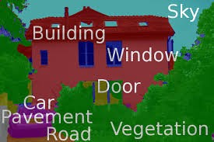
Semantic Segmentation
Semantic segmentation is the task of assigning a class to every pixel in a given image.
Does not have to separate different instances of the same class.
Two important applications:
Self-driving vehicles: These rely heavily on such segmented images to navigate through routes.
Medical imaging: segments correspond to different tissue classes, organs, pathologies, or other biologically relevant structures.

Slide 4
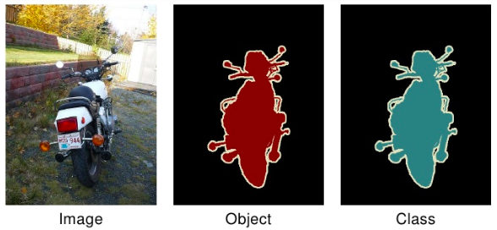
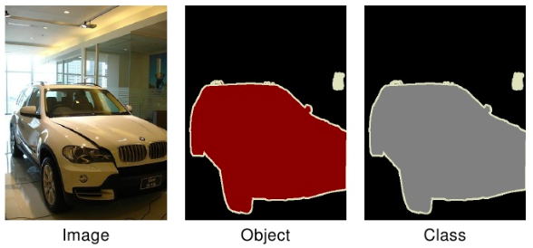
Dataset – Pascal VOC
21 classes:
aeroplane, bicycle, boat, bottle, bus, car, cat, chair, cow, dining table, dog, horse, motorbike, person, potted plant, sheep, train, TV.
background class
Assignment of one of the 21 classes to every pixel in an image.

Slide 5
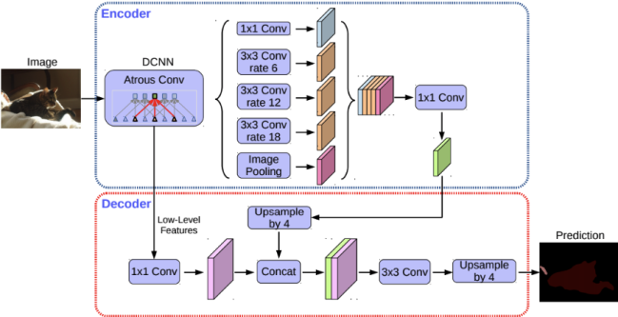
Deeplabv3+ Architecture - Overview
Broadly composed of two steps:
Encoding phase: main purpose is to extract essential information from the image.
Decoding phase: use extracted in encoding phase is used here to reconstruct output of appropriate dimensions.
Use Atrous Convolution and Separable Convolutions to reduce computation.
Combine Atrous Spatial Pyramid Pooling Modules and Encoder-Decoder Structures.

Slide 6
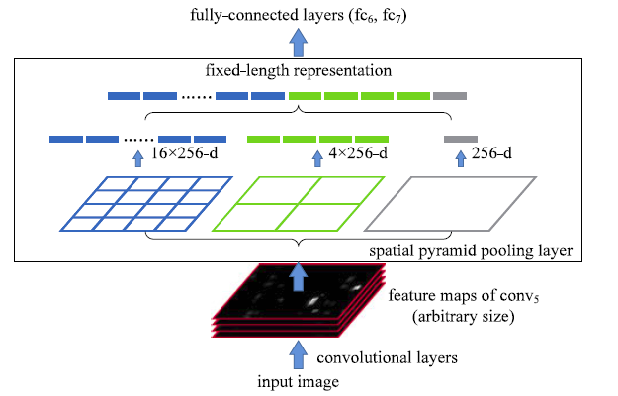
Spatial Pyramid Pooling
To make sure our model is robust to changes in the size of objects when working with CNNs.
These use multiple scaled versions of the input for training and hence capture multi-scale information.
Done by pooling operations at multiple rates and with an effective field of view.
Use parallel versions of the same underlying network to train on inputs at different scales and combine the features at a later step.

Slide 7
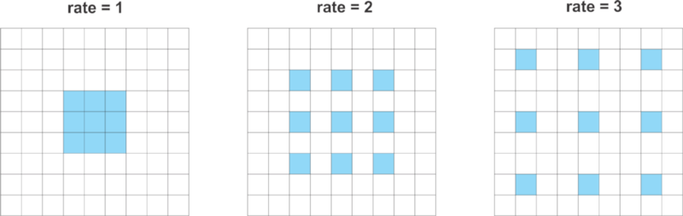
Atrous Convolution
Atrous Convolution is also known as Dilated Convolution.
The normal convolution is a special case of atrous convolutions with r = 1.
Can capture information from a larger effective field of view while using the same number of parameters and computational complexity.
DeepLab uses atrous convolution with rates 6, 12 and 18.

Slide 8
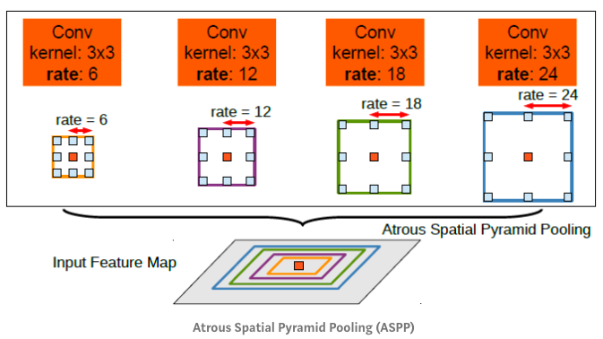
Atrous Spatial Pyramid Pooling
An atrous version of Spatial Pyramid Pooling.
Parallel atrous convolution with different rate applied in the input feature map, and fuse together.
Improving prediction performance on multi-scale object
In Deeplab, one 1×1 convolution and three 3×3 convolutions with rates = (6, 12, 18) when output stride = 16.

Slide 9
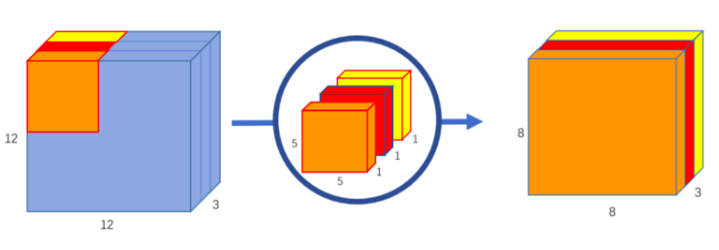
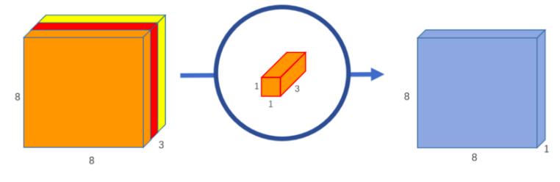
Depth-wise Separable Convolutions
A technique for performing convolutions with less number of computations than a standard convolution operation
Break down the convolution operation into two steps:
Depth-wise convolution
Pointwise convolution.
Xception in Deeplab uses point-wise convolution to depth-wise convolution.

Slide 10
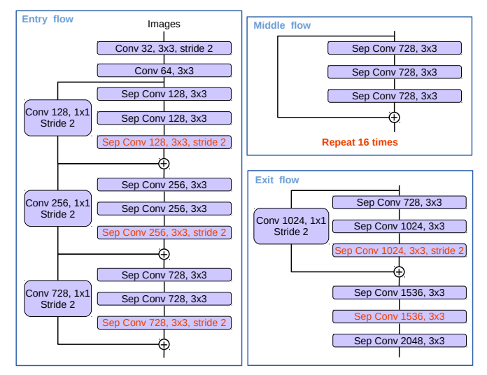
Encoder Structure
The Encoder reduces the spatial sizes of feature maps, while extracting higher level semantic information.
Uses Aligned Xception as its main feature extractor.
Xception an extreme Inception Network.
All max pooling operations are replaced by depthwise separable convolution with striding.
Extra batch normalization and ReLU activation are added after each 3 x 3 depthwise convolution.
Depth of the model is increased without changing the entry flow network structure.

Slide 11
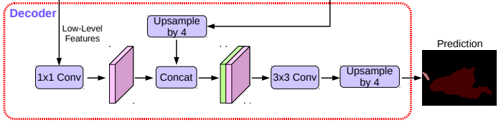
Decoder Structure
Apply 4-fold bilinear up-sampling on the ASPP outputs.
Apply 1x1 Convolution with reduced filter number on a intermediate feature layer.
Concatenate ASPP outputs with intermediate features.
Apply two 3x3 Convolutions
Apply 4-fold bilinear up-sampling.
the output is of the same size as that of the input image.
using output stride = 16 for the encoder module strikes the best trade-off between speed and accuracy.

Slide 12
Steps to execute
Load the dataset from the Pascal VOC Devkit link for 2012
http://host.robots.ox.ac.uk/pascal/VOC/voc2012/index.html
GitHub Link for the project repository:
https://github.com/AtrayeeNag/Image-Segmentation-deeplabv3

Slide 13
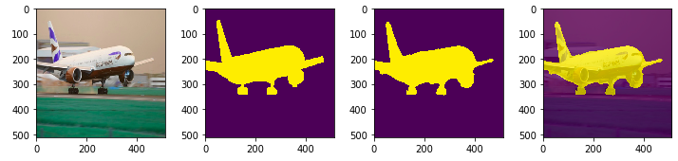
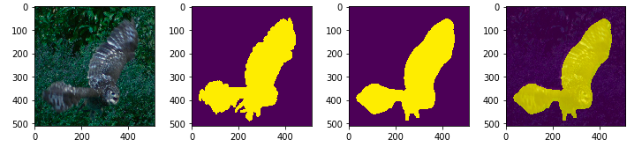
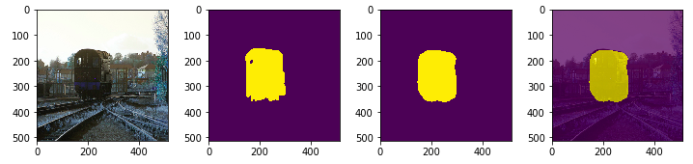
Segmentation results from the Model

Slide 14
References
https://towardsdatascience.com/review-deeplabv3-atrous-convolution-semantic-segmentation-6d818bfd1d74
https://towardsdatascience.com/types-of-convolutions-in-deep-learning-717013397f4d
https://medium.com/coinmonks/review-sppnet-1st-runner-up-object-detection-2nd-runner-up-image-classification-in-ilsvrc-906da3753679
https://towardsdatascience.com/a-basic-introduction-to-separable-convolutions-b99ec3102728
https://www.analyticsvidhya.com/blog/2019/02/tutorial-semantic-segmentation-google-deeplab/

Slide 15
Thank You

